Slide 1
Vehicle Rental System
Anurag Saini(19BCS2078), Sonu(19BCS2069)

Slide 2
Introduction
The main objective of the application Vehicle Rental System require a temporary vehicle, for example those who do not own their own car, or owners of damaged or destroyed vehicles who are awaiting repair or insurance compensation or travellers who are out of town. In existing system the response time from the service was ordinary because of one-way communication which deteriorates the market and goodwill of the organization. It also consumes unnecessary time and efforts, thereby making it not feasible for customers who do not have time to spare on such bookings while leading their fast lives.
Mainly there are two types of user
Admin
Normal user.

Slide 3
Tools to Implement Project
During coding and design of the software Project, Visual Studio Code, at front-end tool HTML & CSS and Bootstrap is used for getting User Interface (UI) based integrated platform and coding simplicity. As a back-end My SQL and PHP is used as per requirement.

Slide 4
Hardware & Software requirement
Hardware Requirement-
Intel i3 processor or similar processor based PC at Client/Server end.
Standard I/O devices like Keyboard and Mouse etc.
Software Requirement-
Windows 10 is desirable.
Visual Studio Code.
Xampp.

Slide 5
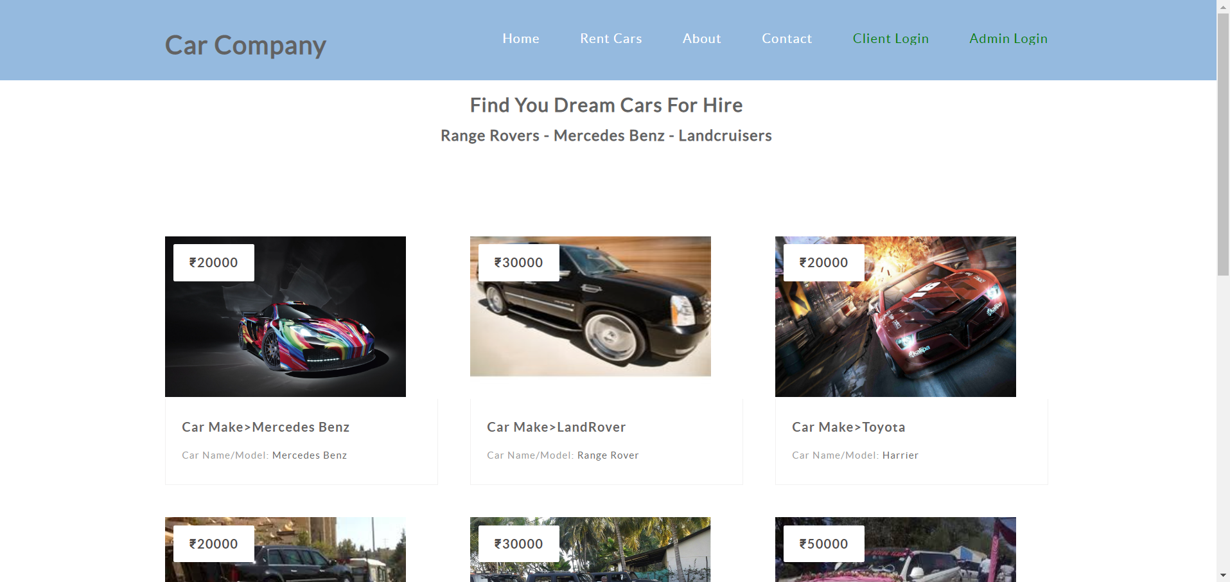
System Design & Development
User dashboard - Home Interface:

Slide 6
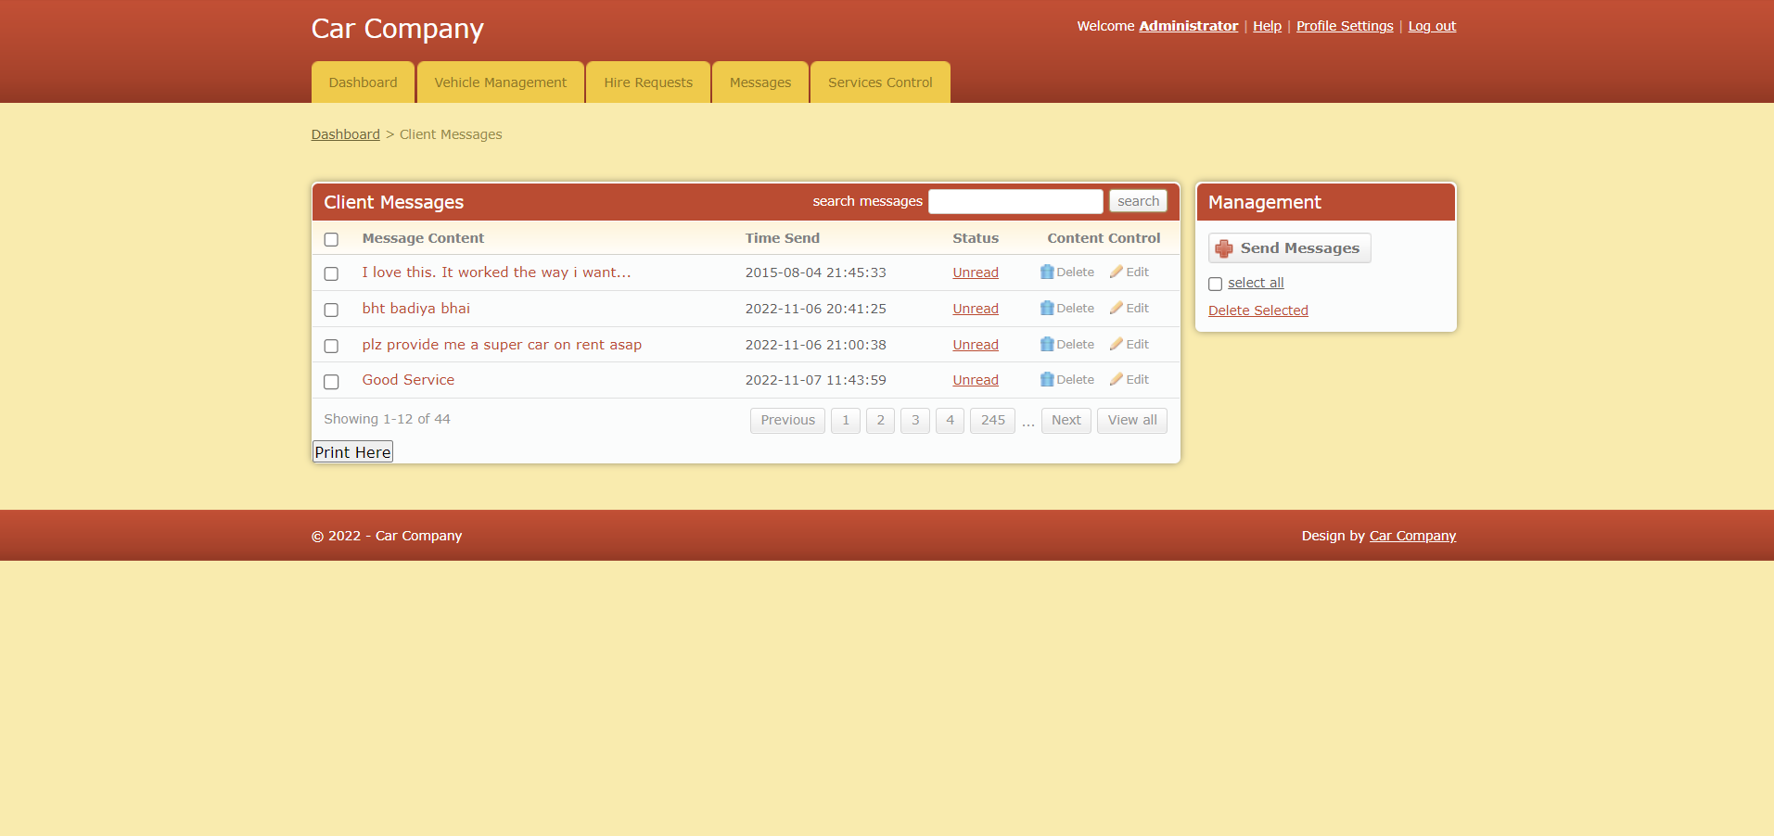
System Design & Development
Admin dashboard - Home Interface:

Slide 7
Problem Definition & Analysis
The hardest part of building a website is deciding precisely what to build. No other part of the conceptual work is as difficult as establishing the detailed technical requirement. Defining and applying good, complete requirements are hard to work, and success in this endeavour has eluded many of us. Yet, we continue to make progress.
Problem definition and Analysis is the activity that encompasses learning about the problem to be solved, understanding the needs of customer and users, trying to find out who the user really is, and understanding all the constraints on the solution.

Slide 8
THANKS!

